Slide 1
SAMA UI/UX
By Arman Khalili, Matin Asabolzohur, Yazdan Afra

Slide 2
Menu
Professor pages ……………………………………….. 3
Student Pages …………………………………………. 12

Slide 3
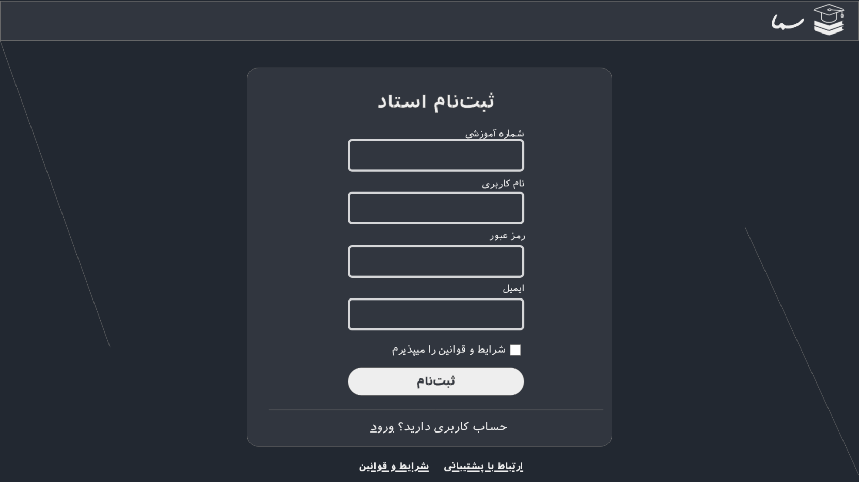
Prof Sign Up
Professor Pages

Slide 4
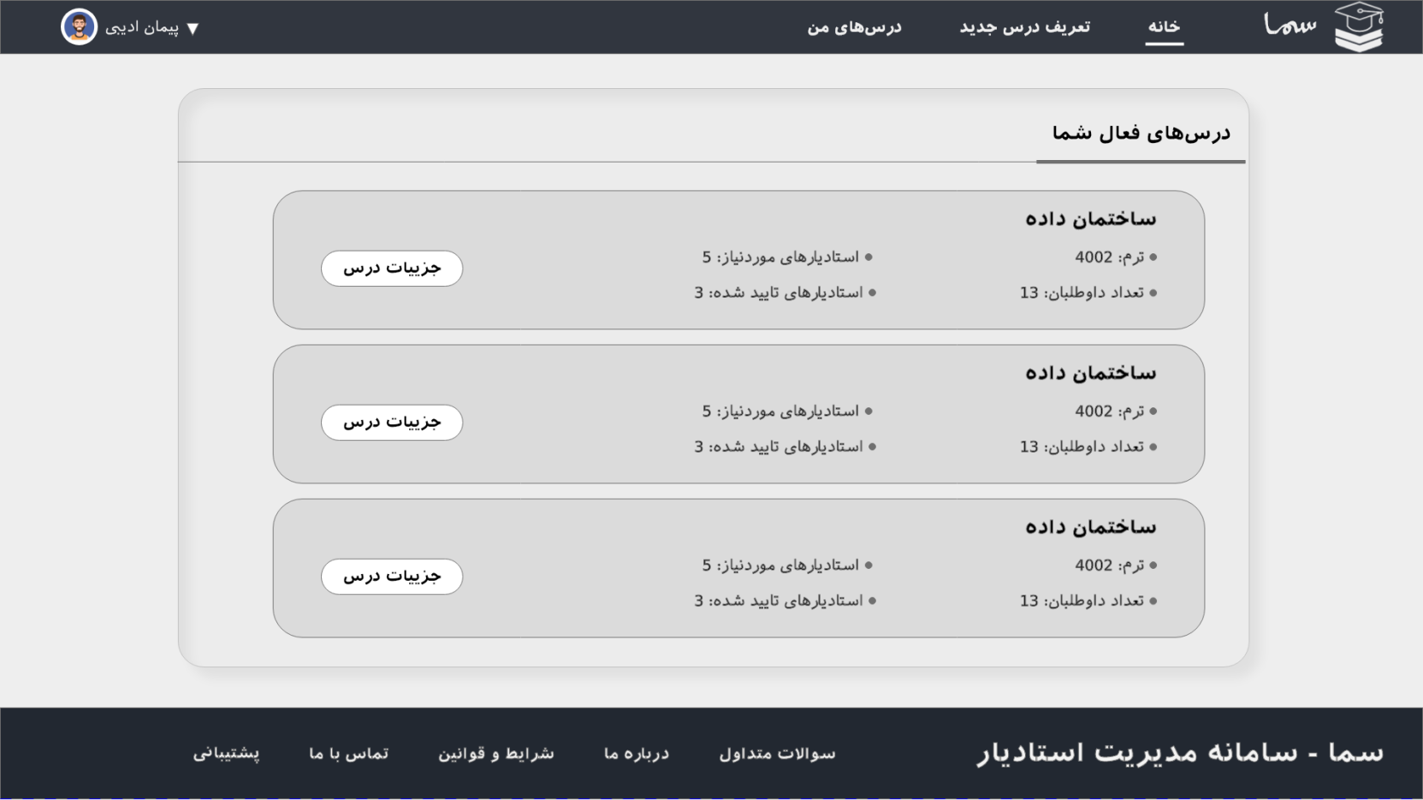
Professor Homepage
Professor Pages

Slide 5
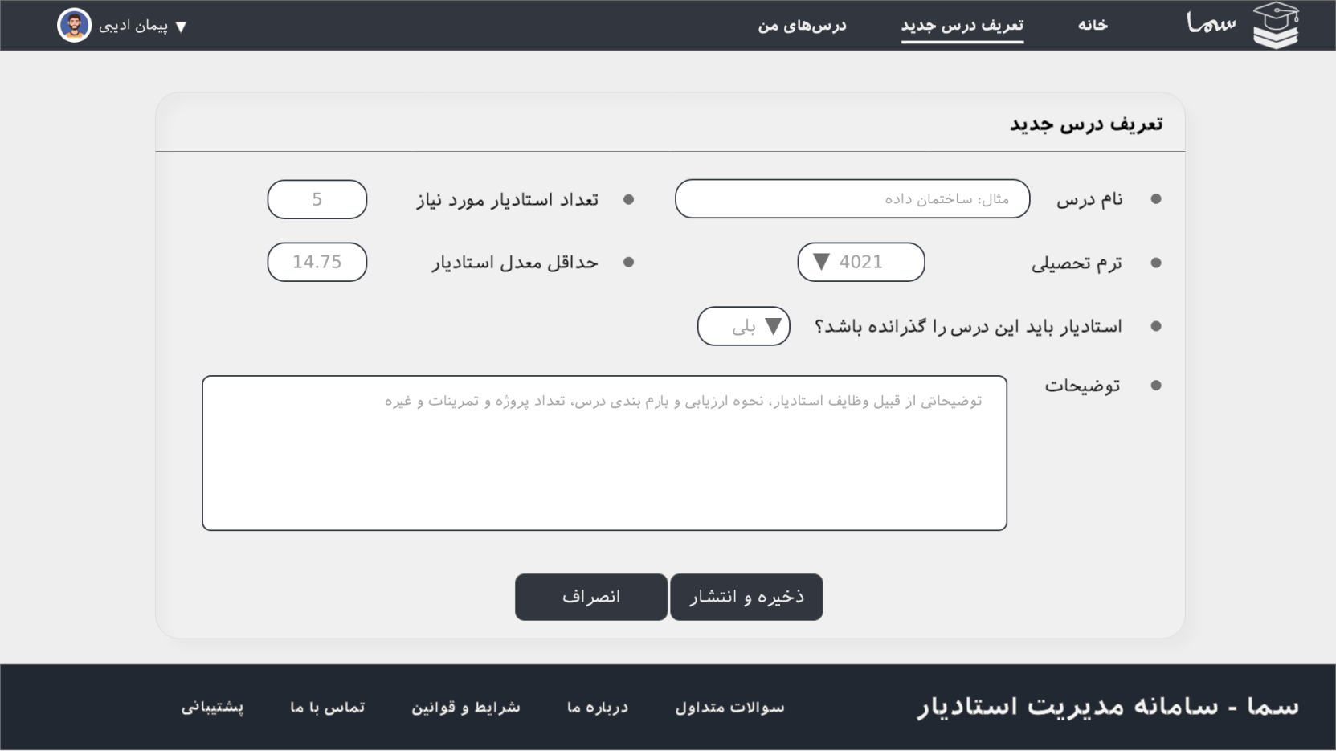
Professor Lesson Creation
Professor Pages

Slide 6
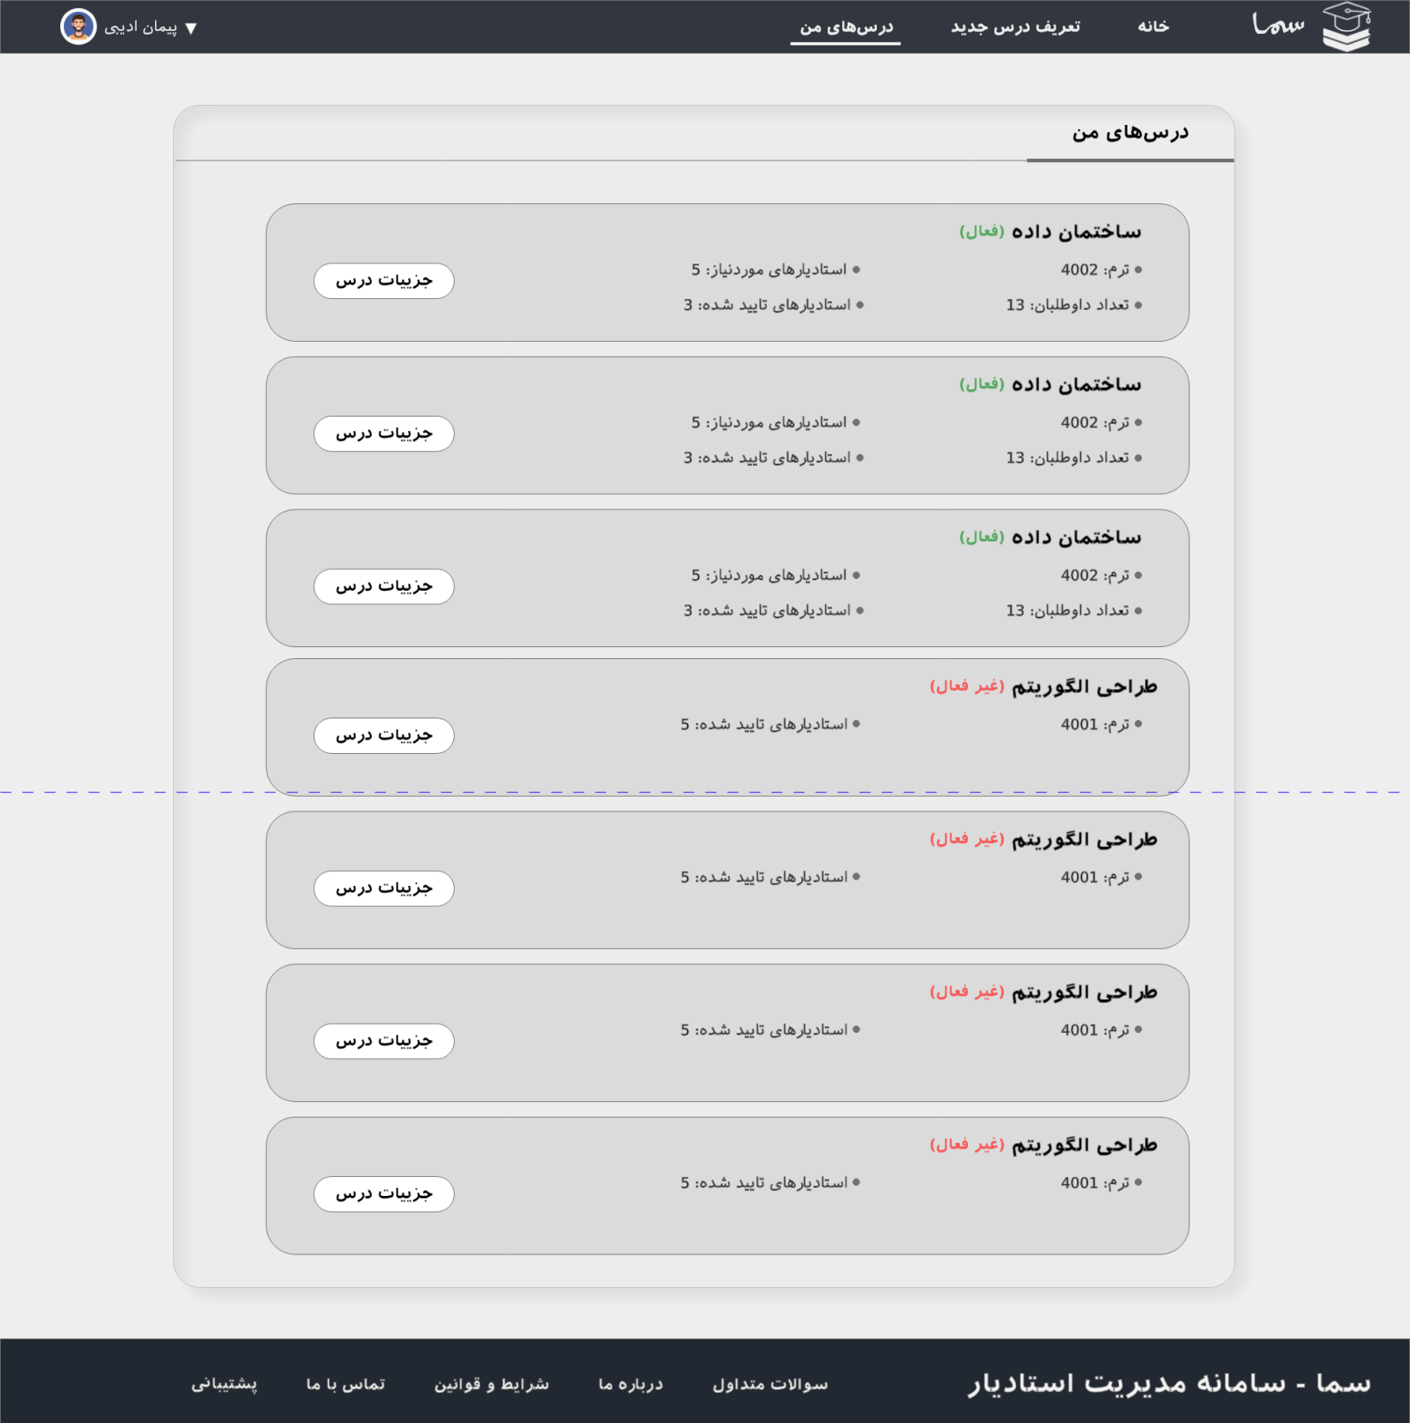
Prof
Lessons
Professor Pages

Slide 7
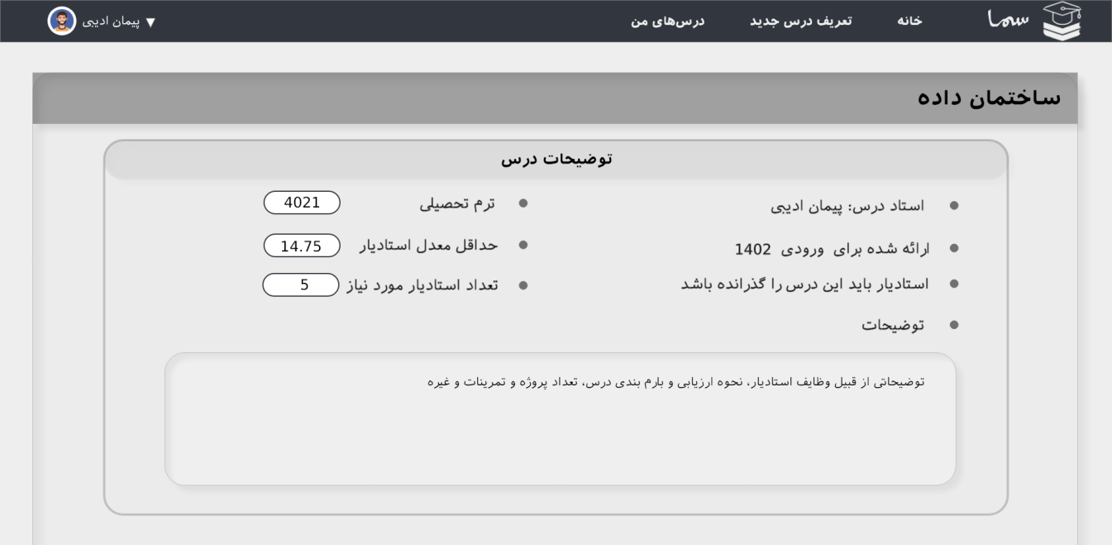

Prof Lesson Details
Professor Pages

Slide 8
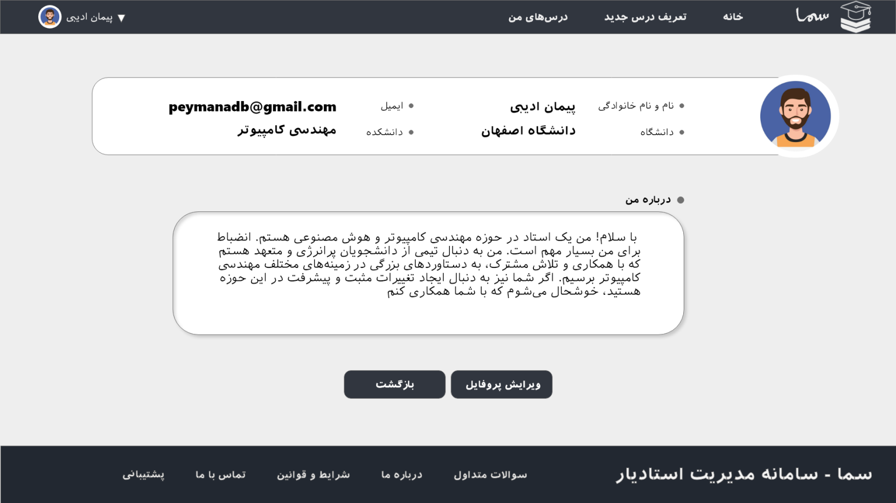
Prof Profile
Professor Pages

Slide 9
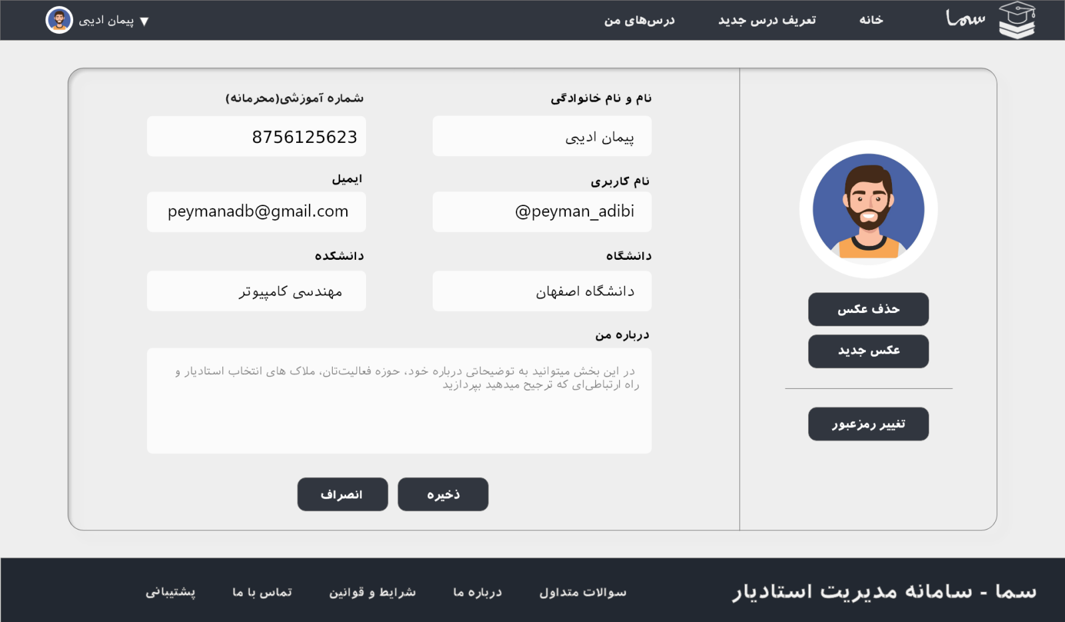
Prof Edit Profile
Professor Pages

Slide 10
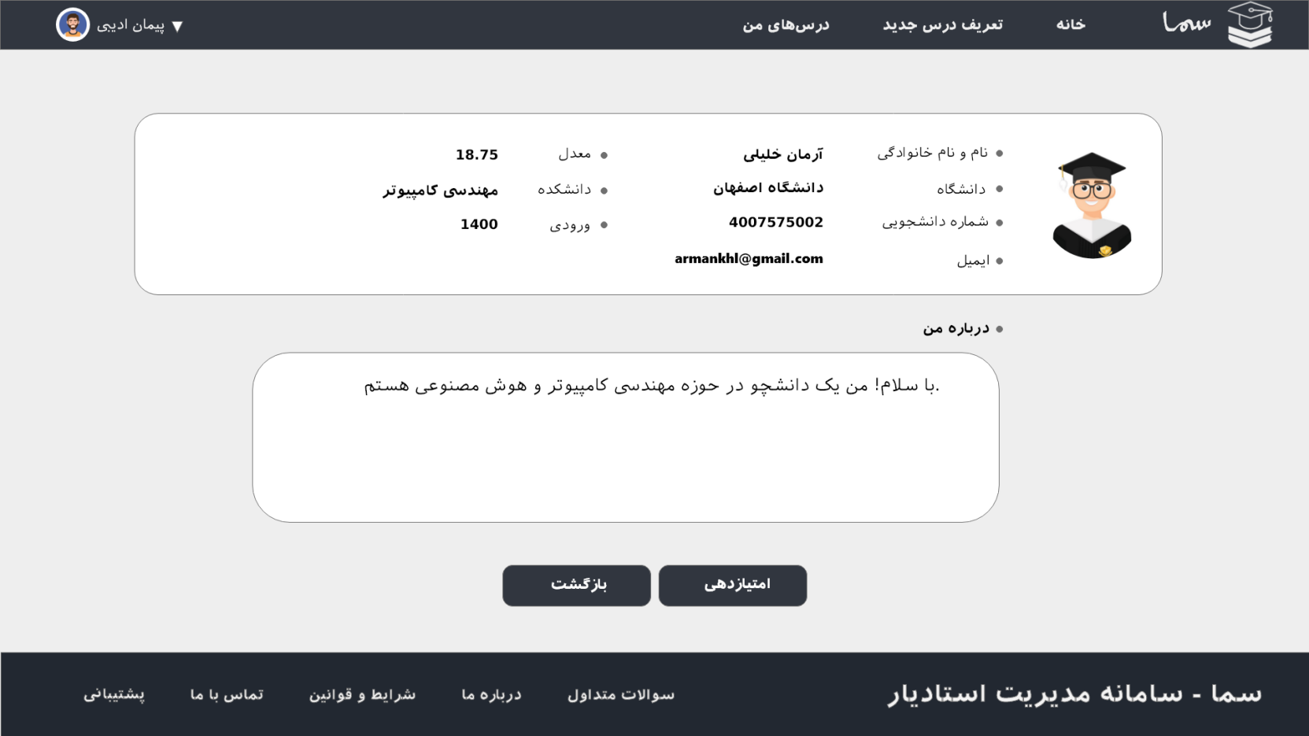
Prof Stu Profile POV
Professor Pages

Slide 11
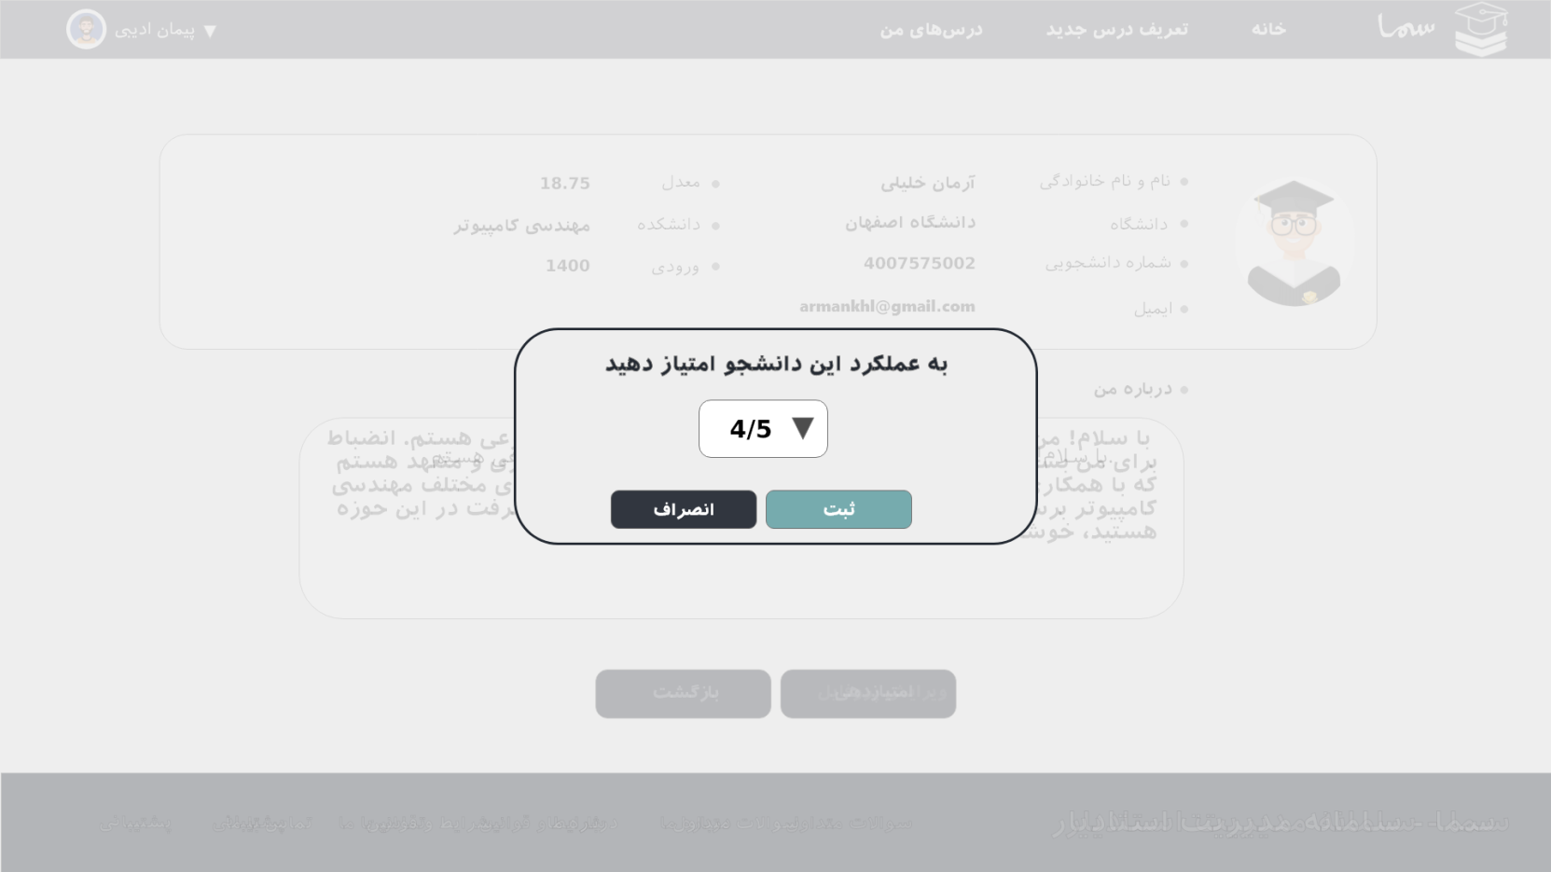
Prof Grading Stu
Professor Pages

Slide 12
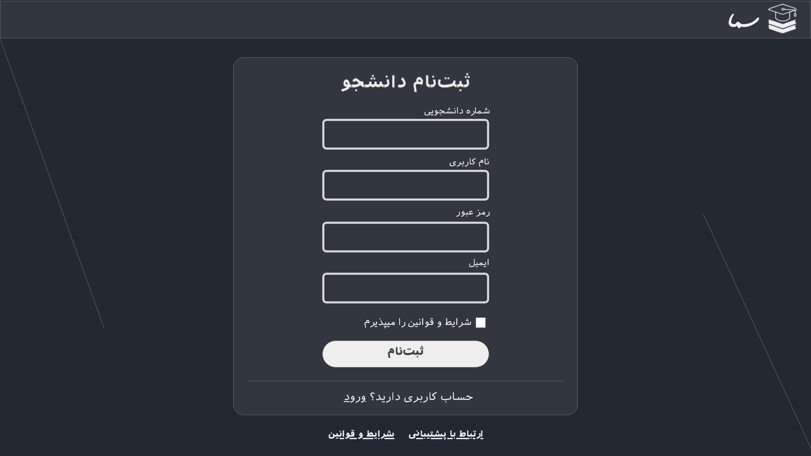
Stu Sign Up
Student Pages

Slide 13
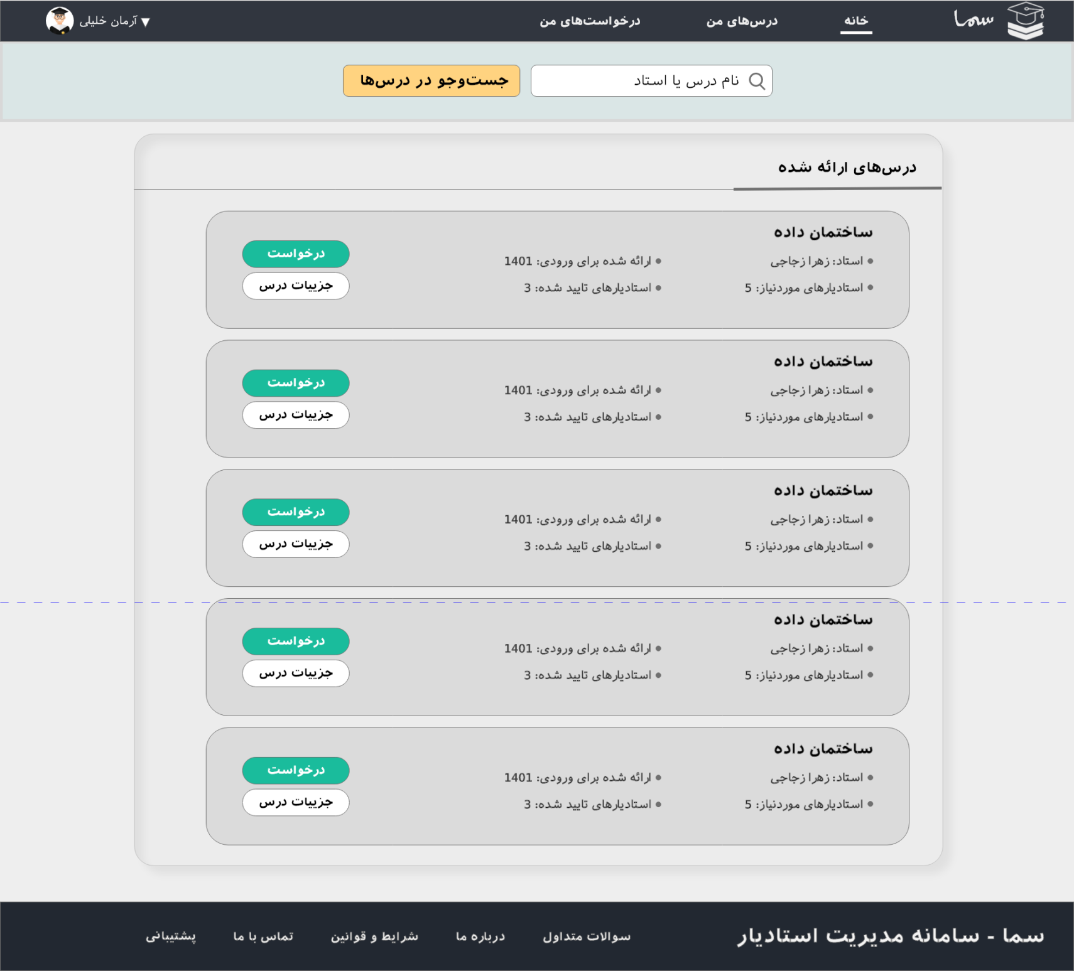
Stu
Home page
Student Pages

Slide 14
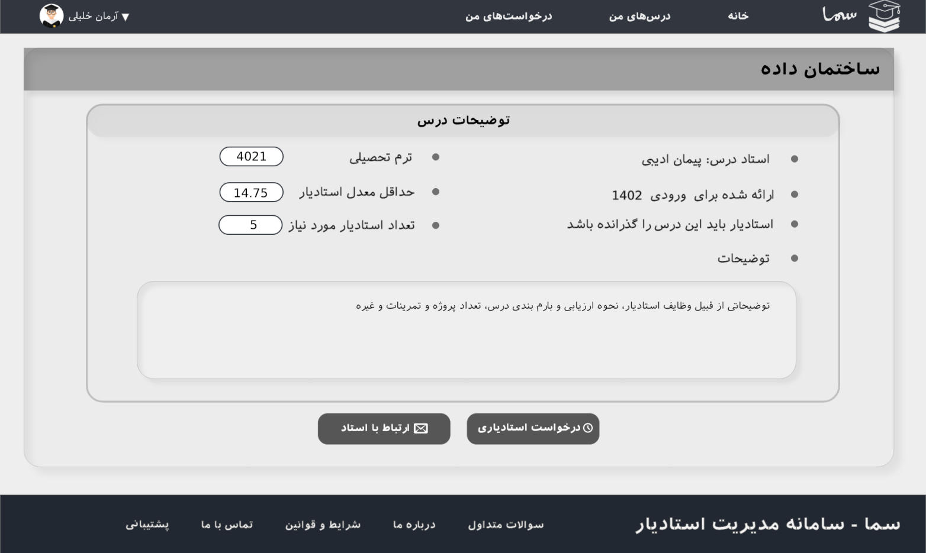
Stu Lesson Details POV
Student Pages

Slide 15
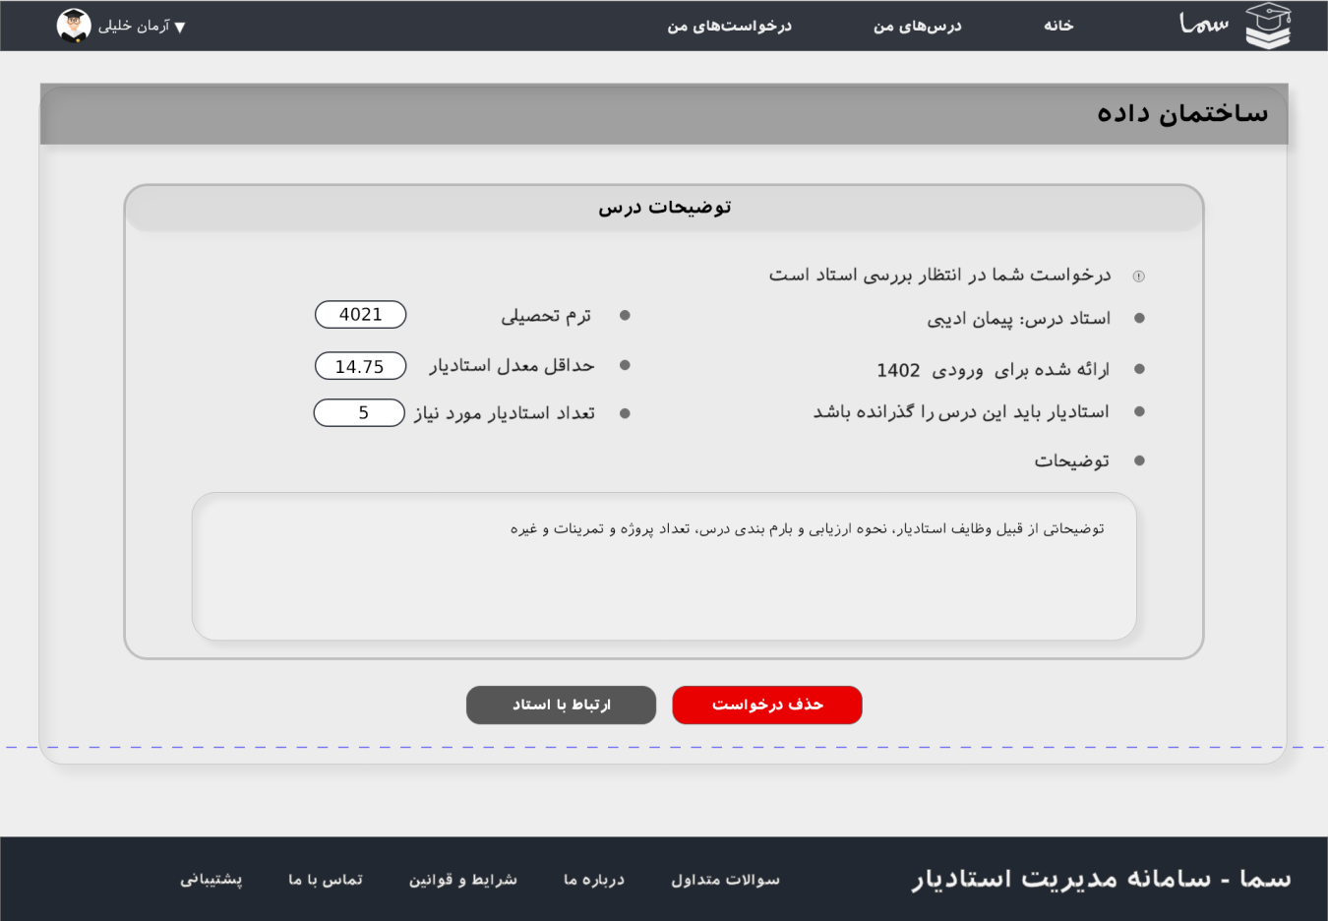
Stu Requested For TA
Student Pages

Slide 16
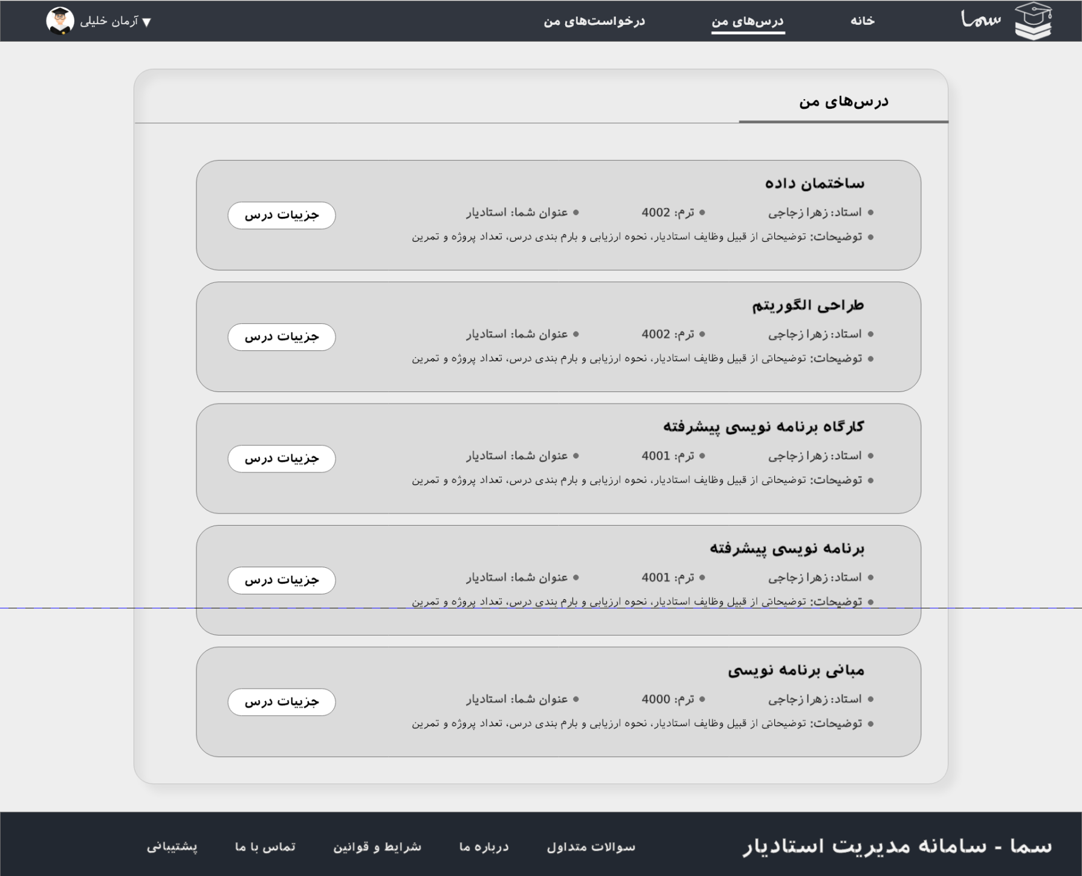
TA
My Lessons
Student Pages

Slide 17
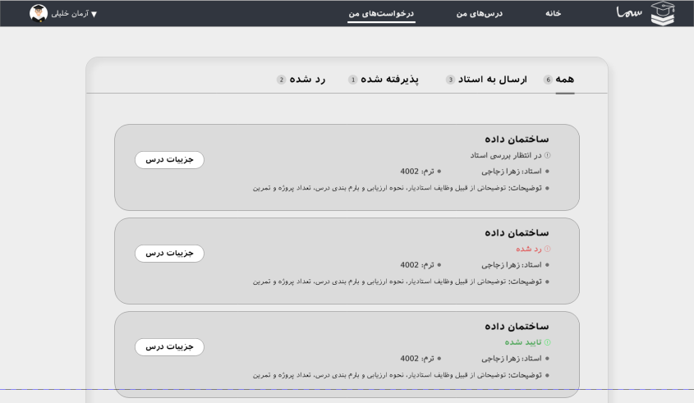
Stu
My Requests
Student Pages

Slide 18
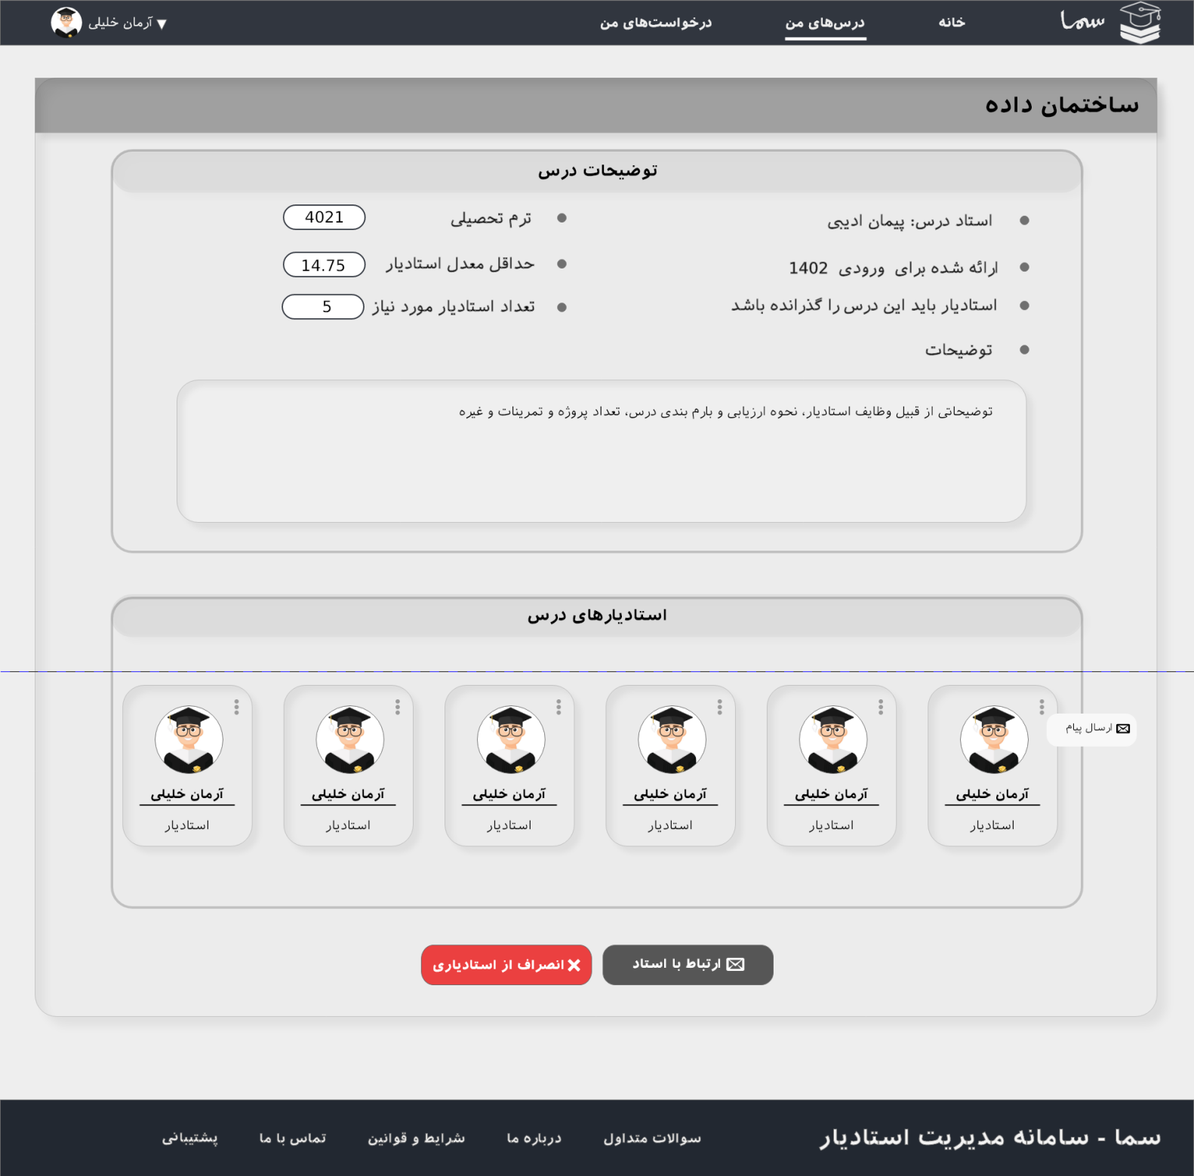
TA Lesson details
Student Pages

Slide 19
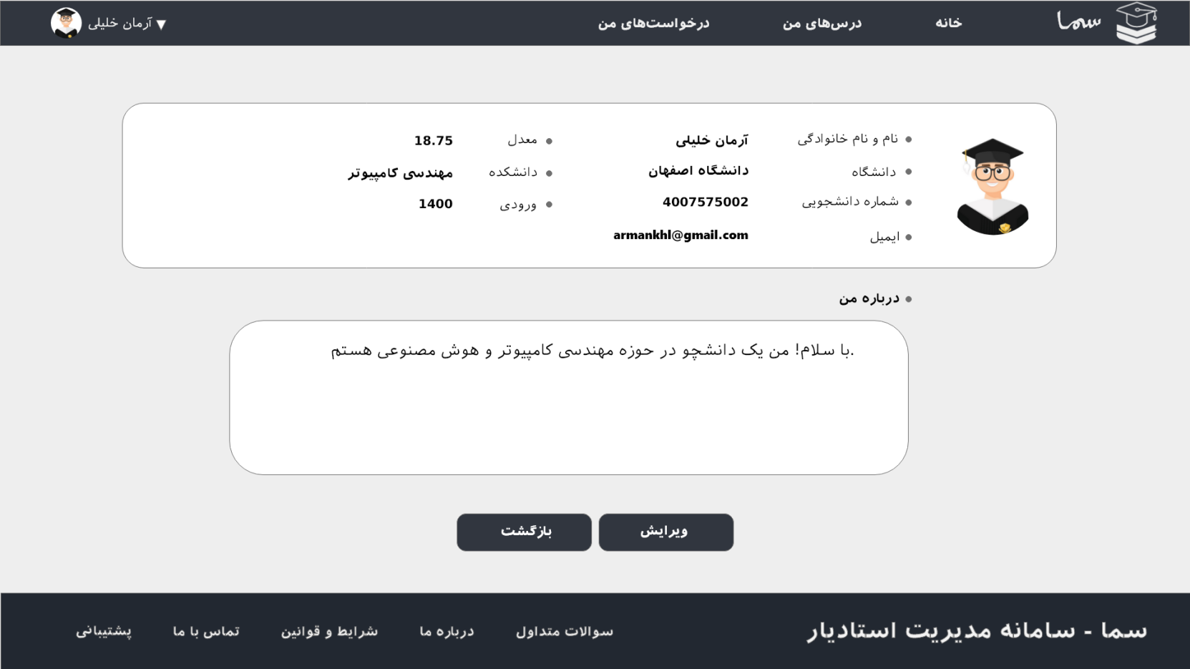
Stu Profile
Student Pages

Slide 20
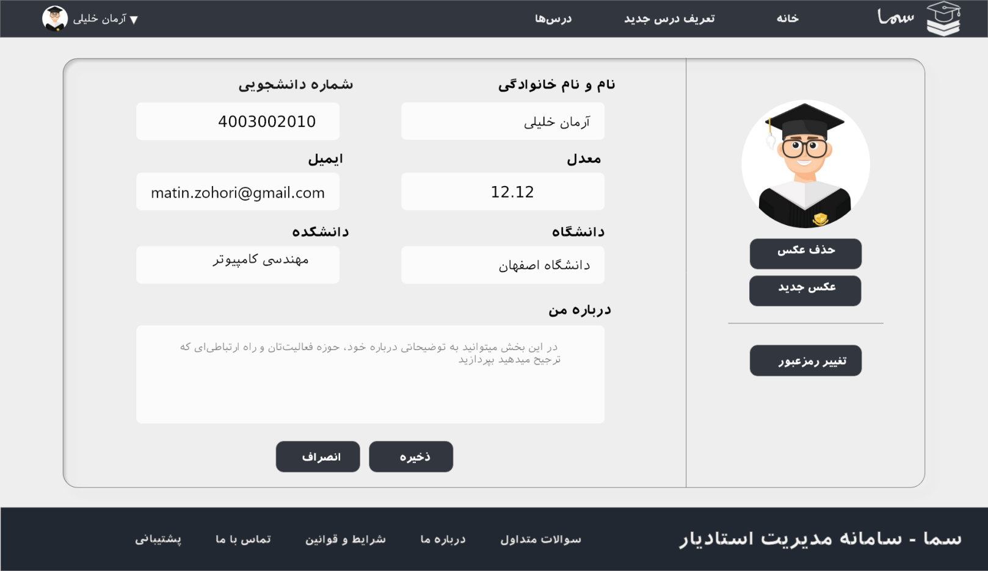
Stu Edit Profile
Student Pages

Slide 21
Thanks for being genius about your time!

